Slide 1
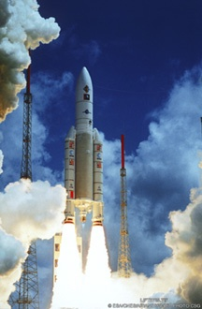
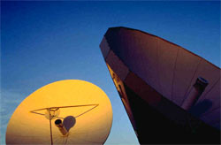
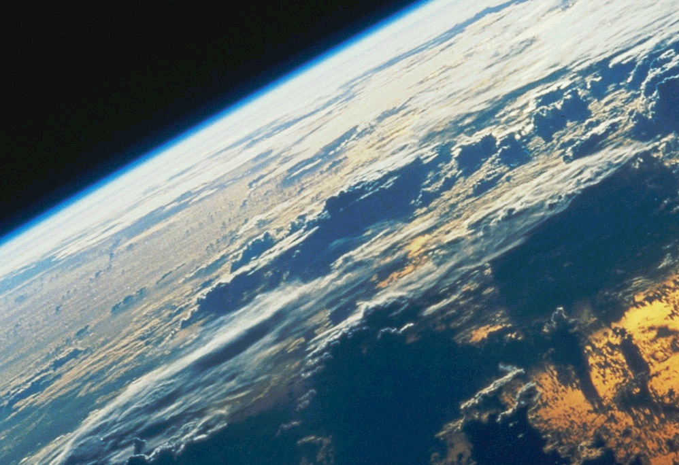
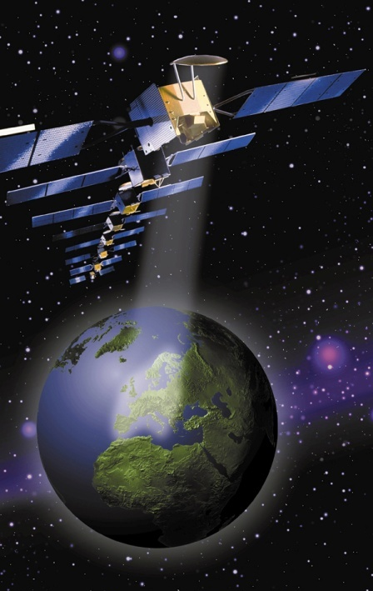
Satellite Hall of Fame and Museum
A project of the Society of Satellite Professionals International and allied organizations

Slide 2
The Satellite Gallery at the National Electronics Museum
A Project of the
Society of Satellite Professionals International (SSPI) in partnership with
Ariane Space
Global Satcom Inc.
Hughes Network Systems/Echostar
Intelsat & Inmarsat & IEEE
International Launch Services
Lockheed Martin & Boeing (Pending) & SES (Pending)
*******
Arthur C. Clarke Foundation
Comsat Alumni and Retirees Association (COMARA)
Intelsat Retirees and Alumni Association (IRAA)
Satellite Interference Reduction Group
********
The State of Maryland
Smithsonian National Air and Space Museum
Trust funds of John Puente, Maryann Elliott, David Lee, etc.

Slide 3
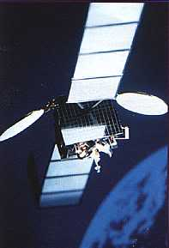
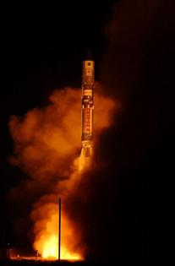
THE VISION
Highlight the milestones that led to the sophisticated products and services we use today and history.
Honor the achievements of the pioneers
that made these advancements
possible.
Collect, preserve and exhibit artifacts
and documents that trace the
history. Donations include Intelsat V,
Ariane V, Proton launcher, VSATs,
Inmarsat terminals, videos from L-M, etc.

Slide 4
EXCITING & COMPREHENSIVE DESIGN
Complete story of Satellite Communications, Space Navigation, Remote Sensing & Strategic Surveillance, and Weather Satellites told within a new 1200 sq. ft. display and Pioneer Hall.
Detailed design covers history, key issues and concerns, technology and applications
Preliminary commitments of key artifacts, models, interactive media displays from Global Satcom Inc., Hughes Network Systems/Echostar, Intelsat, Inmarsat, ILS, Lockheed Martin, Smithsonian NASM, COMARA.
Also to be a web site and 60 page brochure for visitors and students (to promote Science Technology Engineering and Math (STEM) education. (Grant from IEEE)

Slide 7
The National Electronics Museum

Slide 8
About the National Electronics Museum
The National Electronics Museum is a place like no other.
Only here can visitors can learn about the history of defense,
system and space electronics, see cutting edge technology,
and experience the wonders electronics and magnetism. The
museum offers exhibits on radar, radio, electronic warfare,
satellite communications, infrared sensing, and sonar. Hands
on exhibits allow visitors to recreate pioneer experiments in
electricity, learn how to generate store and use electricity and
manipulate electromagnetic radiation to communicate and
explore the environment.

Slide 9
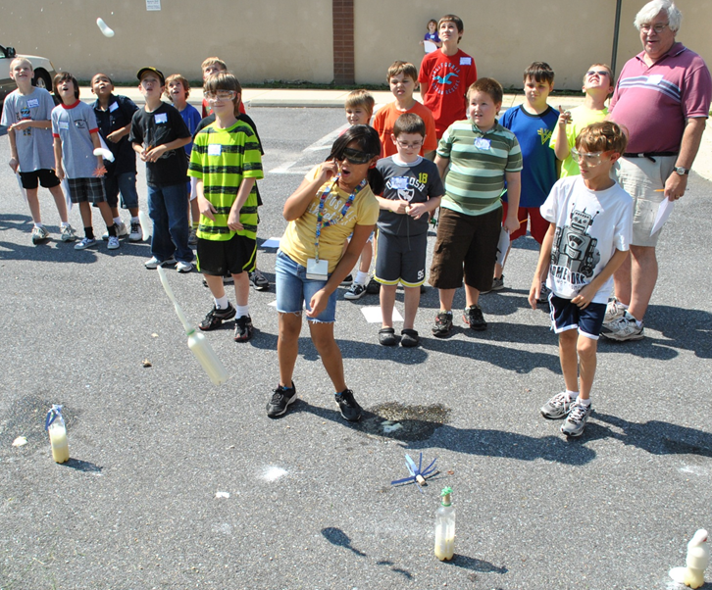
WHY THE NEM IS THE BEST FIT?
Greater DC Area – NEM is a museum in the greater DC area that is connected to the civil, strategic and governmentally-based space industry, and it has an established set of effective and interactive educational programs.
Professional Management : NEM has the experience to develop a professional exhibit that tells the story of “Satellites Transforming Society” effectively and compellingly with a permanent rather than a temporary display.
Strong Student STEM program already
in place.

Slide 10
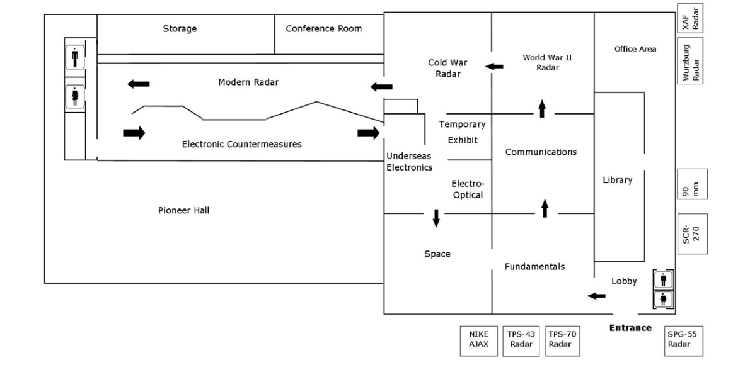
Museum Floor Plan
Exhibit Donations:

Slide 11
Budget and Fund Raising
Exhibit Design, Construction, & Insulation $350,000
Educational Materials $25,000
Community Outreach and website $25,000
Maintenance $25,000
Stewardship $75,000
Total: $500,000
NOTE: $400K raised ($200K from State of Maryland)
Task Force of Denis Curtin, Ellen Hoff, Ramesh Gupta, Scott Chase, Maury Mechanick, Ed Martin (Deceased). Ruth Pritchard Kelly, and Joe Pelton (Chair)

Slide 12
Recognition Opportunities
- Entire exhibition gallery
- An exhibit quadrant
- Exhibit hub
- Entry to exhibition
Single display
10’ x 30’ Exterior Sign Announcing Exhibit

